Slide 1
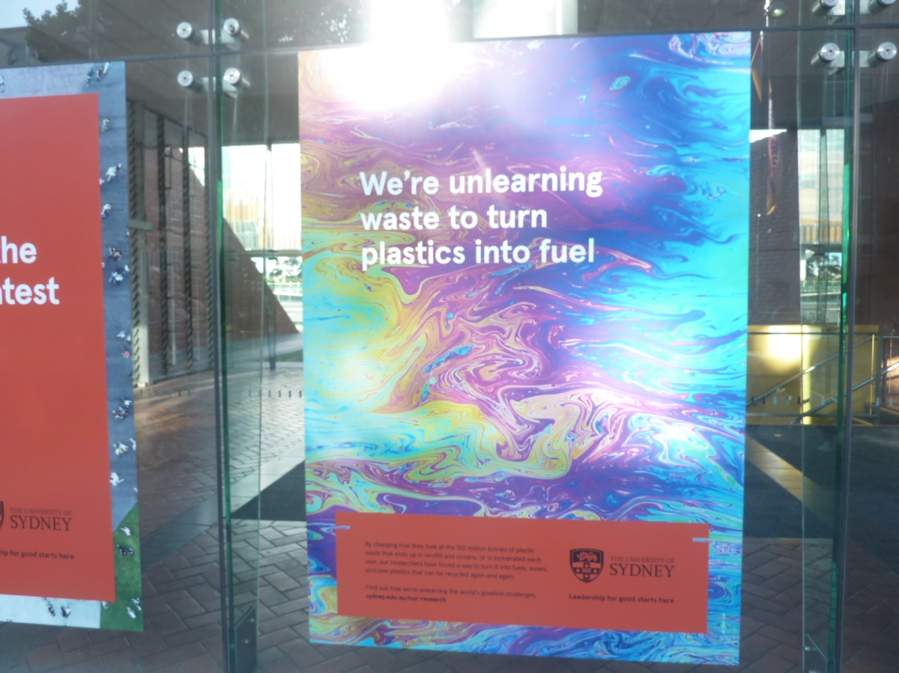
Preamble (1)
Based on a real project – plastics, not ICT
Notes:
Best source of info is Mura Technology https://muratechnology.com/
https://plasticoceans.org/ gives you the scary story about the size of the problem
Based on last term’s project to pitch to The World Bank for a funding a 3rd world project

Slide 2
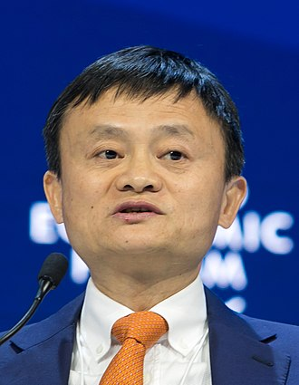
Preamble (2)
Example of what your presentation is about –
business benefits of the technology
How the technology is used
This project may be funded by Jack Ma, so pretend he’s in the audience

Slide 3
Discarded Plastics
Solving the Problem
Notes:
10 minutes from here – maybe mime the changeovers between speakers too.

Slide 4
Introducing the Team
Dr. Steve Mahon, CEO of Mura Technologies
Prof. Thomas Maschmeyer, University of Sydney, developer of the Cat-HTR technology
Mr. Abel Guterres, Ambassador from Timor Leste
Dr. Len Humphreys, CEO of Licella Holdings
Jo Ruxton, CEO of Plastic Oceans Foundation
Notes:
Speakers – Steve slides 1-5, Tom - slides 6-8, Abel – slides 9-10, Len – slides 11-13, Jo- slides 14 to end

Slide 5
Overview
The Problem
Why its so hard
Large Scale Solution
Application in Timor Leste
Actions Needed
Cost & Timeline
Benefits

Slide 6
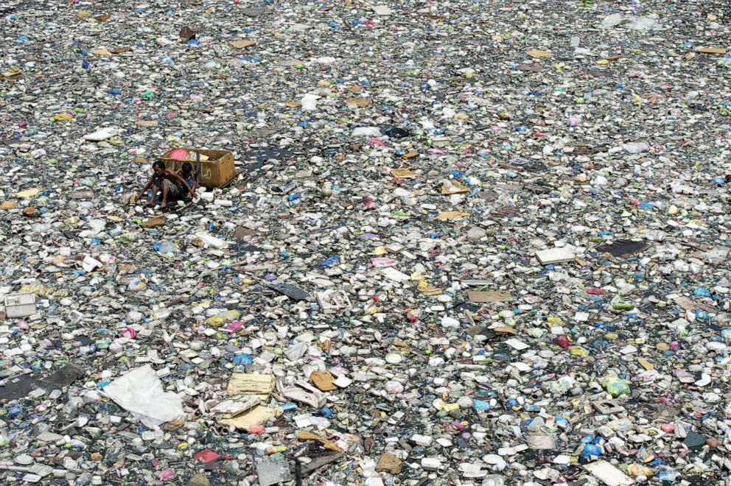
The Problem
Plastic floats
Streams & oceans
Ocean currents
Non-Solutions:
Burn
Bury
A river in Manilla
A man is collecting plastic bottles
Notes:
Much discarded plastic winds up in the oceans & currents gather it into huge islands or dump it on remote beaches

Slide 7
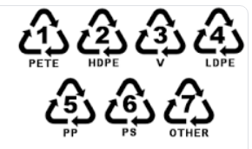
Why its so hard
Many types of plastic – different solutions
Sorting & additives
Many partial solutions
Plastic bottles
Lumber & furniture
Low grade products
Not profitable
Now, only 50% can be recycled - contaminated
Notes:
The ‘recycling’ doesn’t really solve the problem – just moves it along a bit.

Slide 8
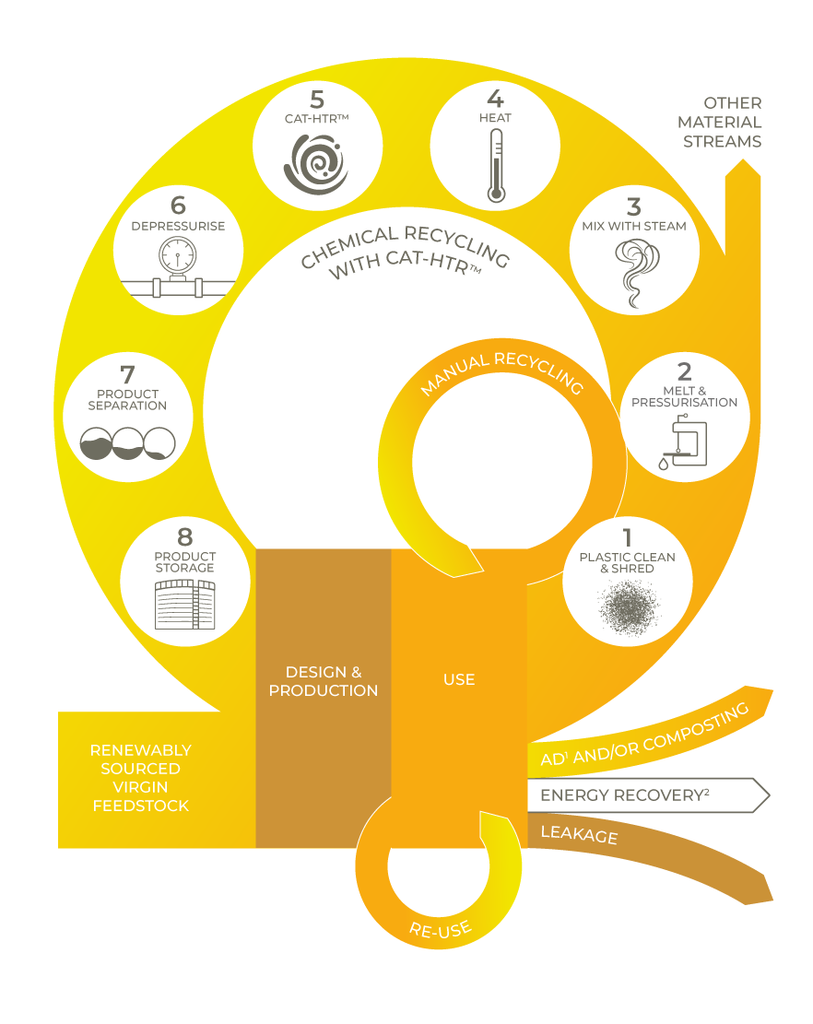
Large Scale Solution
Cat-HTR technology can fully recycle mixed plastics.
The Cat-HTR™ technology doesn’t have a limit on the number of times plastic can be re-used – it offers infinite product recycling.
Developed by Prof Thomas Maschmeyer from University of Sydney and his team
Notes:
Entirely new solution, 10 years in the making, from idea to working prototype
Complex process, but a cycle takes 20 mins to convert a pile of rubbish into high value products

Slide 9
Cat-HTR technology
Cat-HTR - plastics combined with water at high temperature & pressure
Separate into types & additives
new products – liquids, solids, reactive gasses
industrial waxes, lubrication oils, solvents
new plastics & fuels
High value products
20 minutes, low impact
Notes:
Plastic means many things – its not just 1 product

Slide 10
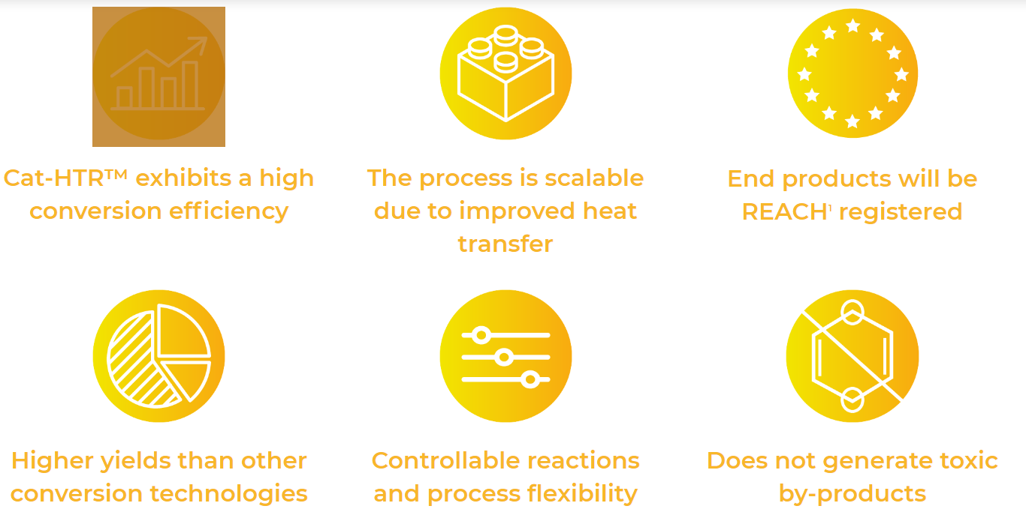
Improved Process
Notes:
Conversion efficiency, yield, no toxic by products

Slide 11
Application in Timor Leste
Timor Leste has a plastics problem
70 tonnes of plastic waste daily
Not all of its own making
Willing to try this new method
Prof Maschmeyer needs a demo site
Both need a venture capitalist with $40m
Build the plant & infrastructure
Educate the people of Timor Leste
2 years operation of plant
Notes:
Much of the plastic comes from Indonesia in the ocean. East Timorese fought a long battle to free themselves from Indonesian control. It’s a beautiful place with once pristine oceans
Focus on needs & outcomes, drop in the money casually. Note Govt budgets are in billions (or trillions if USA or China)

Slide 12
Challenges
Money
& capacity to install the plant (England)
Manufacturing
skills, materials & equipment (England)
Education for local staff
capacity to operate & maintain the plant
Self sufficient after 2 years
Market
For end products
Notes:
Plant production in England – 1st real plant being developed there now. Need local staff trained to run it after 2 years

Slide 13
Tasks & Cost Summary
Activity | Cost Est. $M
Clear & prepare the site (Timor Leste) | $3
Install solar panels to power the plant (Germany) | $7
Start stockpiling plastic (Timor Leste) | $2
Build the plant (Western Australia) | $10
Ship to Timor Leste (Shipping Company) | $3
Install the plant (Timor Leste) | $5
Train local staff (Western Australia) | $5
Launch the new plant (Timor Leste) | $1
Operate & maintain the plant (Timor Leste) | $4
Totals | $40
Cost estimates based on industry best practice with 10% allowance for education & training costs
More details are provided in the accompanying report
Notes:
I made this up. I’m trying to explain that the chemistry is a small part of the project
I think its important to focus on how the costs are justified, not just made up numbers
And give high level details here with more detail on the report. Don’t side track the sales pitch with too many numbers

Slide 14
Timeline
Year 1
Year 2
Year 3
Year 4
Year 5
Clear & prepare the site
Install solar panels
Stockpile plastic
Build the plant
Ship
Install the plant
Train local staff
Launch
Operate & maintain the plant
Time estimates based on industry best practice with 10% allowance for education & training
More details are provided in the accompanying report
Notes:
Again, I made it up. The point is to provide a simple graphic that shows the big picture, including training, installation & ongoing operation

Slide 15
Project Benefits
Income stream for Timor Leste
sale of products, self sustaining
profitable after 2 years
Pay locals to collect plastics
Plastic neutral country
Future – neighbours pay to recycle their plastics
Prof. Maschmeyer
Demo site for other countries
Continue to refine process & methods
Venture Capitalist
Profit from future sales of plant to wealthy countries
5% of sales from Timor Leste
More details are provided in the accompanying report
Notes:
Again, I made it up. There are several parties who will benefit

Slide 16
Global Benefits
Recycling is not a waste problem, it’s a resource opportunity
an economy that generates value from traditional waste
using recycled plastic reduces total energy consumption by 80 % & limits emissions by 70% compared with virgin plastics
Recycling and using recycled materials are good for manufacturers, consumers and the planet.
Notes:
Quotes from Tom and the https://wastemanagementreview.com.au/plastic-recyclers-manufacturing/

Slide 17
Summary
We can solve the worldwide problem of discarded plastics
Step by step, country by country
Saving energy
We need $40 m of your money to start this.
I’m sure you will be proud to be part of this project
Notes:
Mura’s goal is to have the problem sorted by 2030. China are already lining up

Slide 18
References
Manila – polluted river image
https://abcnews.go.com/Technology/breakthrough-discovery-plastic-holy-grail-recycling/story?id=62884758
Garbage Patch
https://theoceancleanup.com/great-pacific-garbage-patch/
Ocean Cleanup
https://www.goodnewsnetwork.org/boyan-slat-launches-barge-fleet-to-collect-river-trash/
Cat HTR image https://www.licella.com.au/cat-htr/
Mura Technology https://muratechnology.com/ good resource
Recycling is not a waste problem, it’s a resource opportunity
https://www.licella.com.au/news/professor-thomas-maschmeyer-recycling-is-not-a-waste-problem-its-a-resource-opportunity/
Plastic Recyclers
https://wastemanagementreview.com.au/plastic-recyclers-manufacturing/
Notes:
Business web sites – not accurate as its left over from an earlier version

Slide 19

https://my.christchurchcitylibraries.com/any-questions/

